Slide 1

Azure DevOps

Slide 2
What is DevOps?
People. Process. Products.
Build& Test
Deploy
DevOps is the union of people, process, and products to enable continuous delivery of value to your end users.
“
Continuous Delivery
Develop
Operate
”
Plan & Track
Monitor & Learn
Notes:
DevOps is the union of people, process and products to enable the continuous delivery of value to your end customers

Slide 3


High Performance DevOps Companies Achieve…
46x Deployment
Frequency
2,555x Faster Lead
Time For Changes
Faster
Time to Market
DevOps
$
Increased
Revenue
7x Lower Change
Failure Rate
2,604x Faster Mean
Time to Recover
Source: 2018 Accelerate: State of DevOps: Strategies for a New Economy." N. Forsgren, J. Humble, G. Kim. DevOps Research and Assessment (DORA)

Slide 4
What technologies do I need to support DevOps?
DevOps brings together people, processes, and technology, automating software delivery to provide continuous value to your users. Using Azure DevOps, you can deliver software faster and more reliably - no matter how big your IT department or what tools you’re using.
Continuous Integration (CI)
Improve software development quality and speed.
When you use Azure Pipelines or Jenkins to build apps in the cloud and deploy to Azure, each time you commit code, it’s automatically built and tested and bugs are detected faster.
Continuous Deployment (CD)
By combining continuous integration and infrastructure as code (IaC), you’ll achieve identical deployments and the confidence to deploy to production at any time.
With continuous deployment, you can automate the entire process from code commit to production if your CI/CD tests are successful.
Continuous Learning & Monitoring
With Azure Application Insights you can identify how your applications are performing and test if the recent deployment made things better or worse.
Using CI/CD practices, paired with monitoring tools, you’ll be able to safely deliver features to your customers as soon as they’re ready.

Slide 5





Introducing Azure DevOps
Azure Boards
Azure Pipelines
Azure Repos
Deliver value to your users faster using proven agile tools to plan, track, and discuss work across your teams.
Build, test, and deploy with CI/CD that works with any language, platform, and cloud. Connect to GitHub or any other Git provider and deploy continuously.
Get unlimited, cloud-hosted private Git repos and collaborate to build better code with pull requests and advanced file management.
Azure Test Plans
Azure Artifacts
➔
Test and ship with confidence using manual and exploratory testing tools.
Create, host, and share packages with your team, and add artifacts to your CI/CD pipelines with a single click.
https://azure.com/devops
Notes:
So does TFS

Slide 6

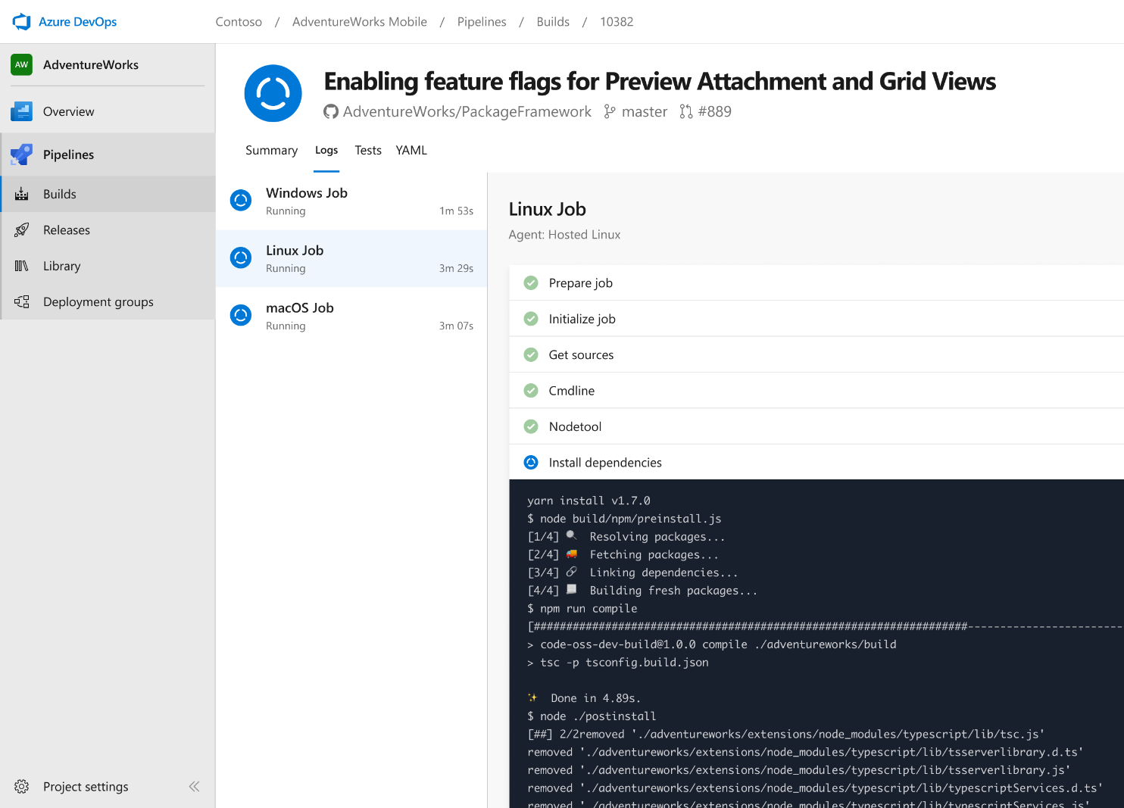


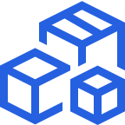

Azure Pipelines
Cloud-hosted pipelines for Linux, Windows and macOS, with unlimited minutes for open source
Any language, any platform, any cloud
Build, test, and deploy Node.js, Python, Java, PHP, Ruby, C/C++, .NET, Android, and iOS apps. Run in parallel on Linux, macOS, and Windows. Deploy to Azure, AWS, GCP or on-premises
Extensible
Explore and implement a wide range of community-built build, test, and deployment tasks, along with hundreds of extensions from Slack to SonarCloud. Support for YAML, reporting and more
Containers and Kubernetes
Easily build and push images to container registries like Docker Hub and Azure Container Registry. Deploy containers to individual hosts or Kubernetes.
Best-in-class for open source
Ensure fast continuous integration/continuous delivery (CI/CD) pipelines for every open source project. Get unlimited build minutes for all open source projects with up to 10 free parallel jobs across Linux, macOS and Windows
➔
https://azure.com/pipelines
Notes:
Azure Pipelines is the perfect launchpad for your code – automating your builds and deployments so you spend less time with the nuts and bolts and more time being creative

Slide 7

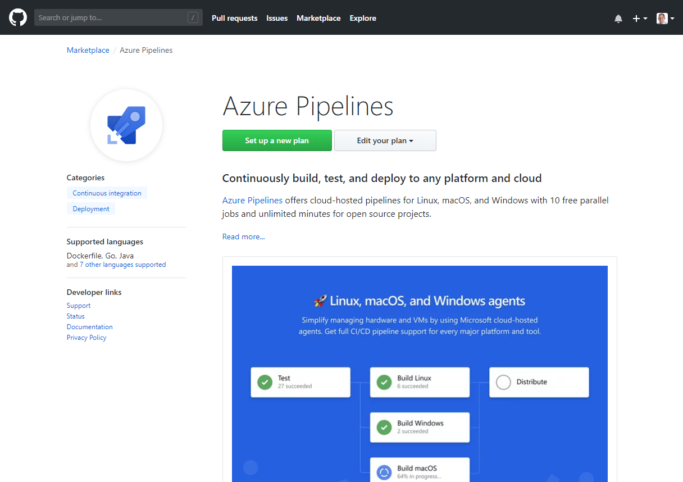
Integrated with GitHub
Azure Pipelines available now to any developer from the GitHub Marketplace

Slide 8

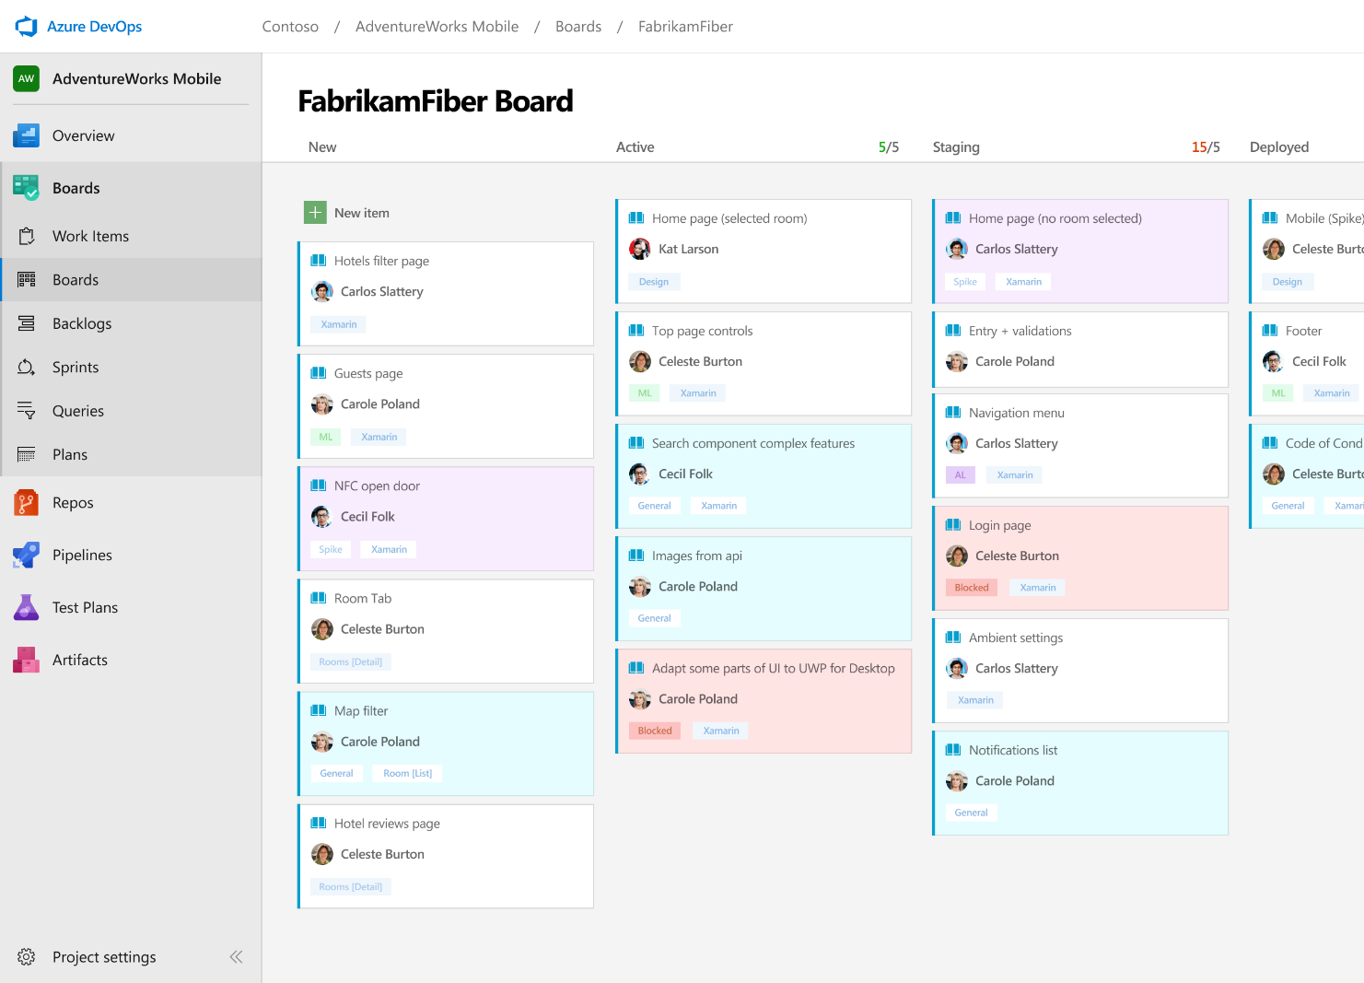



Azure Boards
Track work with Kanban boards, backlogs, team dashboards, and custom reporting
Connected from idea to release
Track all your ideas at every development stage and keep your team aligned with all code changes linked directly to work items.
Scrum ready
Use built-in scrum boards and planning tools to help your teams run sprints, stand-ups, and planning meetings.
Project insights
Gain new insights into the health and status of your project with powerful analytics tools and dashboard widgets.
➔
https://azure.com/devops
Notes:
Combine Kanban boards and drag-and-drop sprint planning with comprehensive traceability and reporting for the perfect home for all your ideas–big and small.

Slide 9
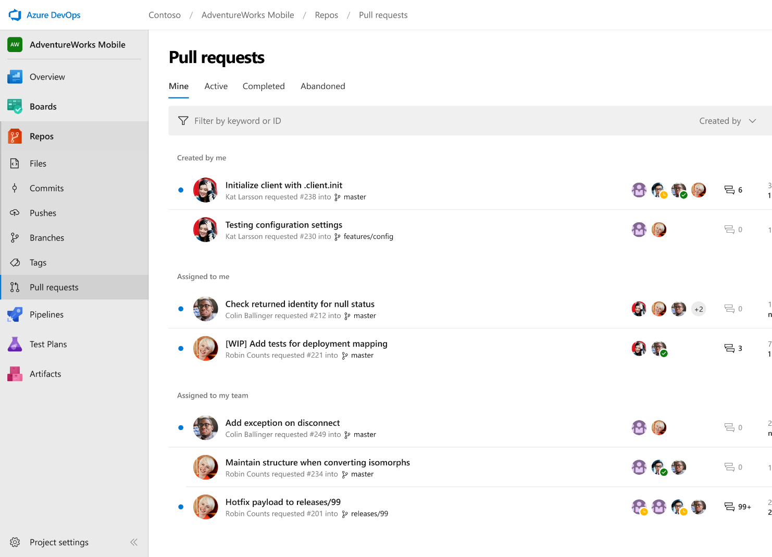



Azure Repos
Unlimited private Git repo hosting and support for TFVC that scales from a hobby project to the world’s largest Git repositories
Works with your Git client
Securely connect with and push code into your Git repos from any IDE, editor, or Git client.
Web hooks and API integration
Add validations and extensions from the marketplace or build your own using web hooks and REST APIs.
Semantic code search
Quickly find what you’re looking for with code-aware search that understands classes and variables.
➔
https://azure.com/devops
Notes:
Collaborate on code changes with threaded discussion and continuous integration for each change. Use forks to promote collaboration with Inner Source workflows.

Slide 10
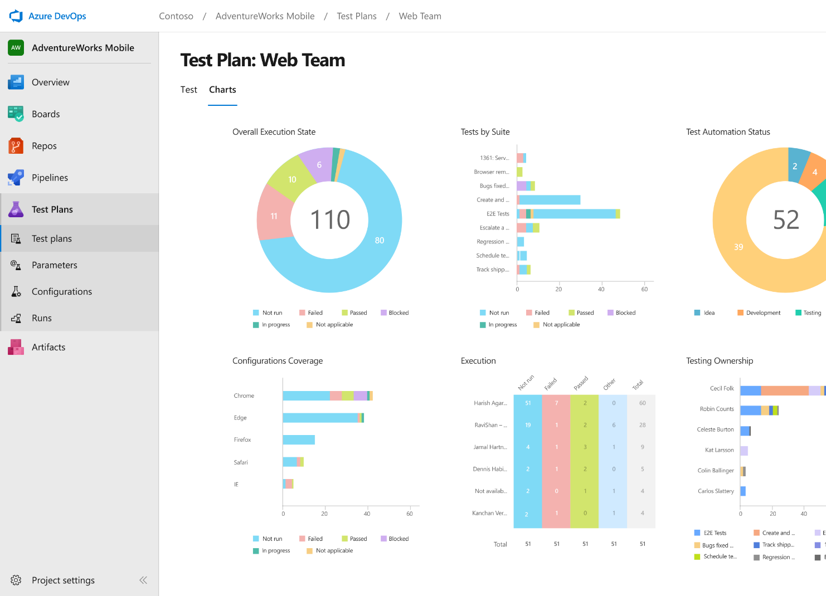
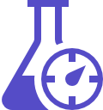


Azure Test Plans
Get end-to-end traceability. Run tests and log defects from your browser. Track and assess quality throughout your testing lifecycle.
Capture rich data
Capture rich scenario data as you execute tests to make discovered defects actionable. Explore user stories without test cases or test steps. You can create test cases directly from your exploratory test sessions.
Test across web and desktop
Test your application where it lives. Complete scripted tests across desktop or web scenarios. Test on-premises application from the cloud and vice-versa.
Get end-to-end traceability
Leverage the same test tools across your engineers and user acceptance testing stakeholders. Pay for the tools only when you need them.
➔
https://azure.com/devops
Notes:
Collaborate on code changes with threaded discussion and continuous integration for each change. Use forks to promote collaboration with Inner Source workflows.

Slide 11
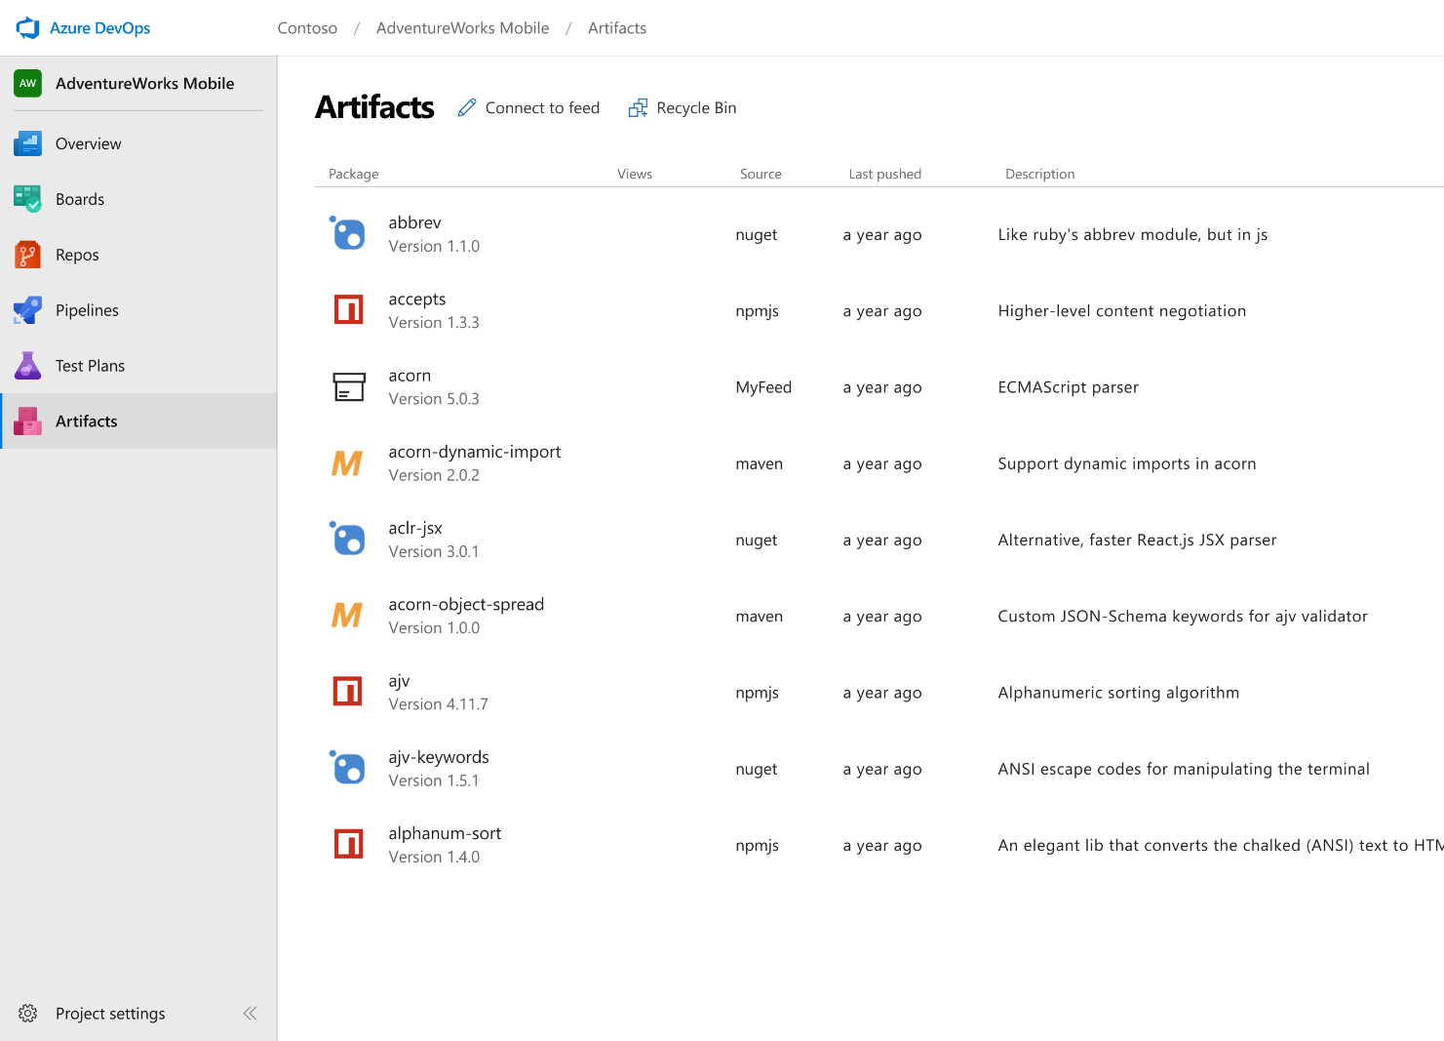



Azure Artifacts
Create and share Maven, npm, and NuGet package feeds from public and private sources – fully integrated into CI/CD pipelines
Manage all package types
Get universal artifact management for Maven, npm, and NuGet.
Add packages to any pipeline
Share packages, and use built-in CI/CD, versioning, and testing.
Share code efficiently
Easily share code across small teams and large enterprises.
➔
https://azure.com/devops
Notes:
Collaborate on code changes with threaded discussion and continuous integration for each change. Use forks to promote collaboration with Inner Source workflows.

Slide 12






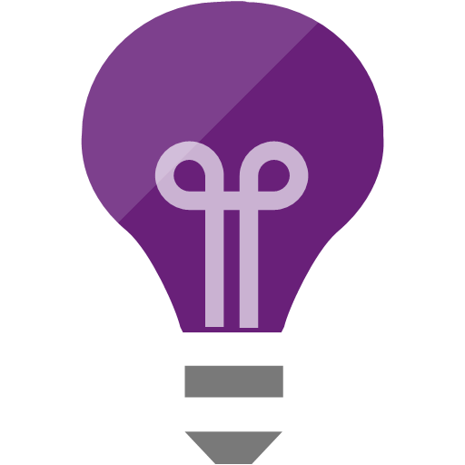

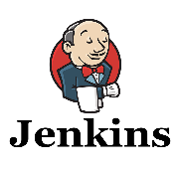
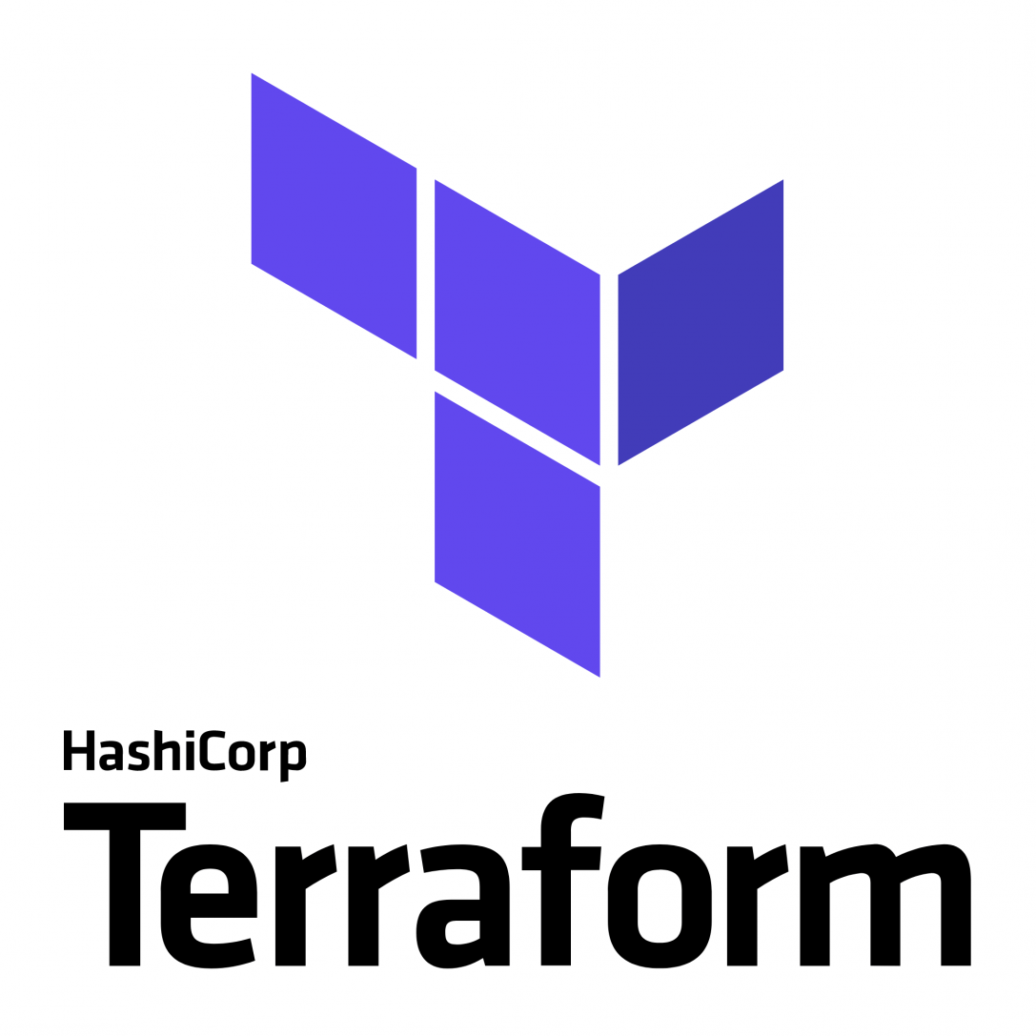



Broadening the Azure Ecosystem
Notes:
So does TFS

Slide 13

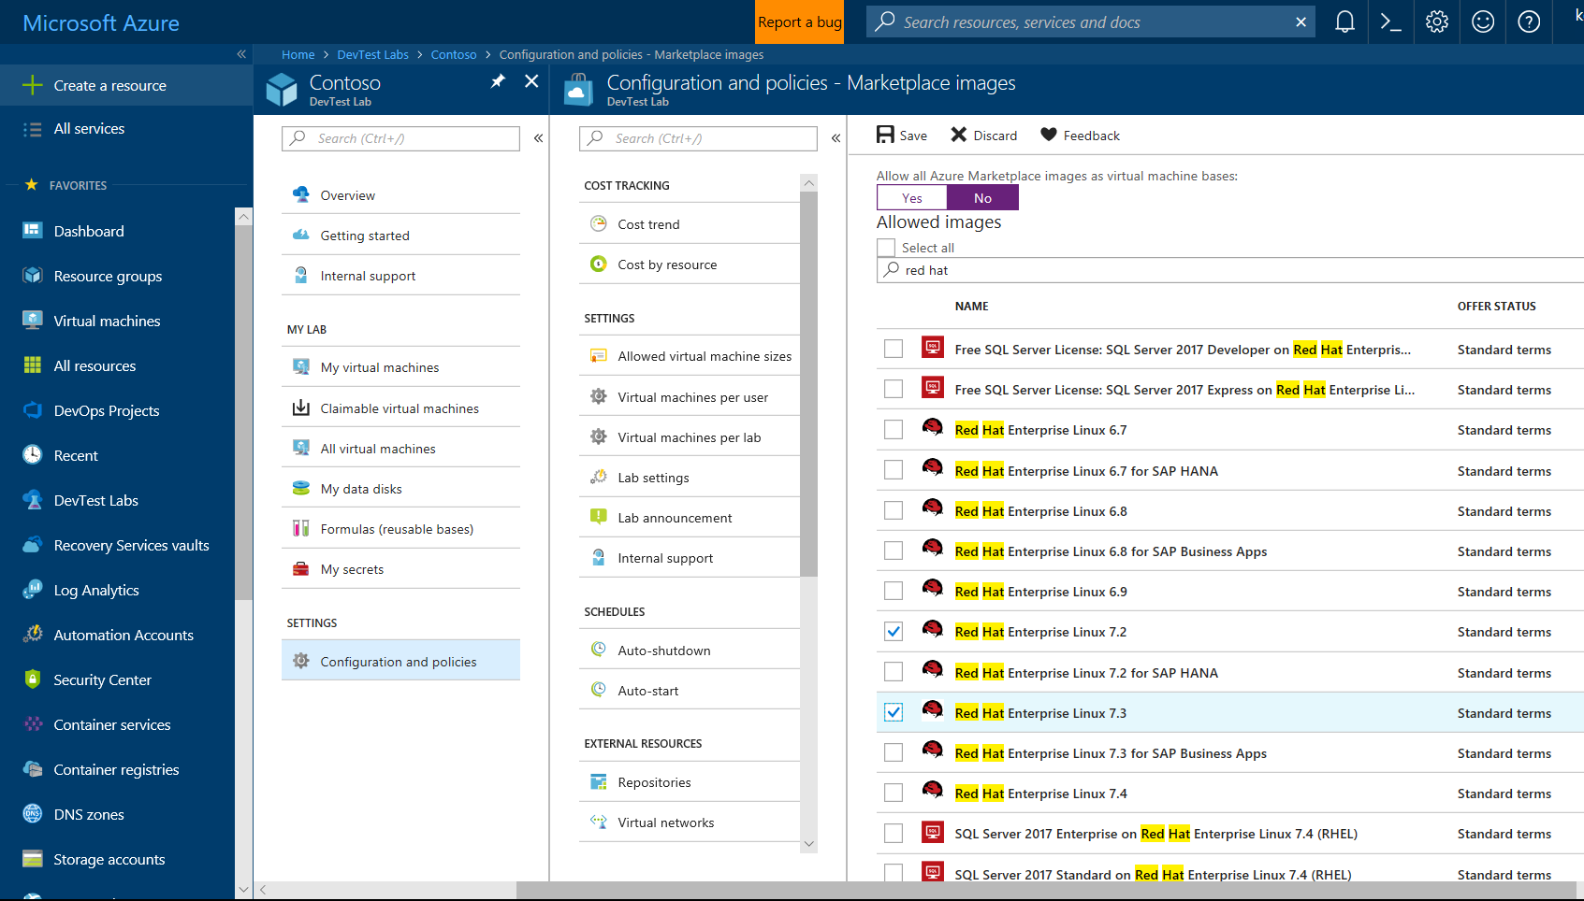
Self-Service Dev/Test Environments
Azure Lab Services
Simplify cloud environment management for developers and testers.
Enforce policies and control costs with full visibility
Use templates, custom images and formulas to reproduce environments.
Orchestrate with Azure Pipelines or integrate using REST API
Notes:
Whether you’ve already started implementing DevOps or looking to get started, a common challenge is for IT organizations is keeping up with project demand for development and test environments
DevTest Labs simplifies environment management for Dev & Test environments in the Azure cloud
Provide self-service access for teams, with policies to control cost and enforce use of appropriate images and artifacts

Slide 14
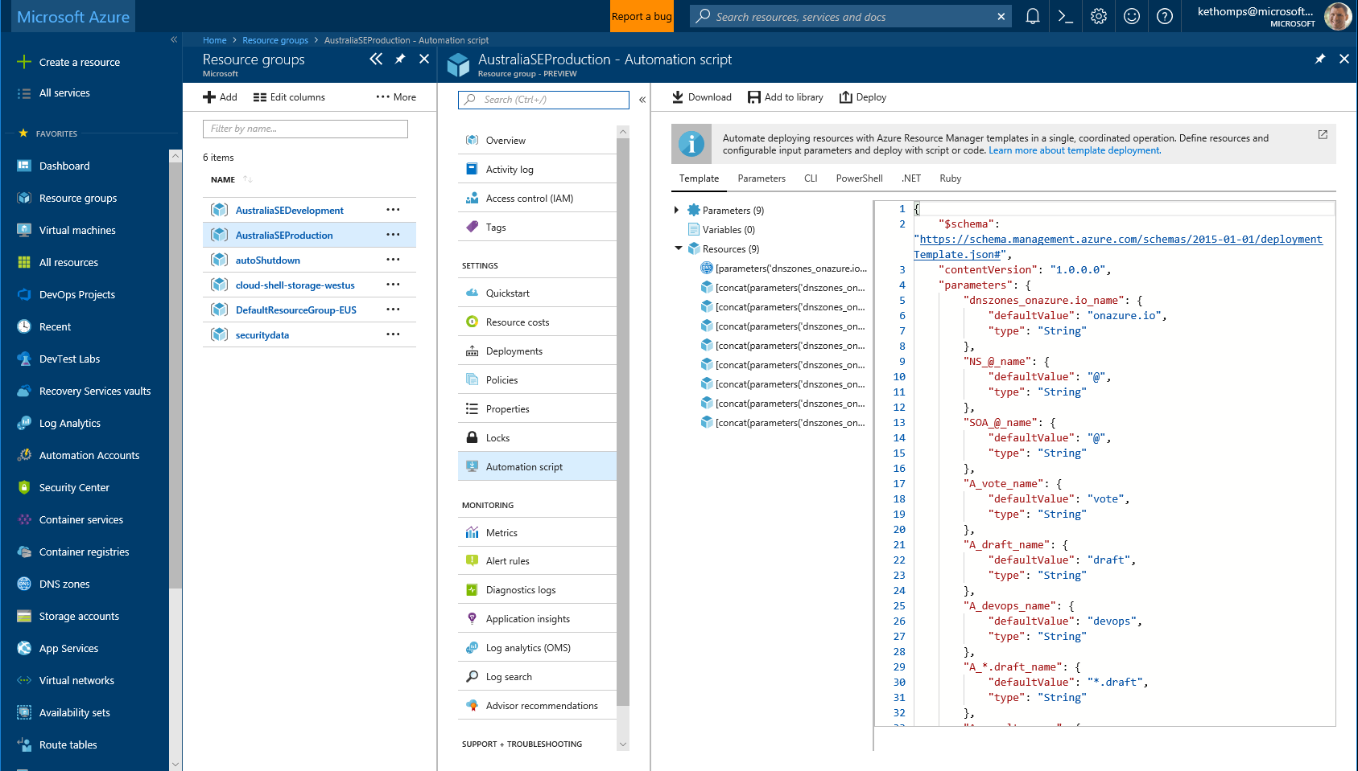
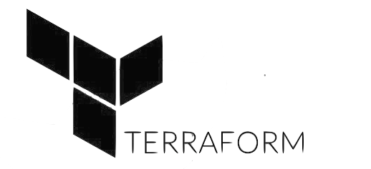

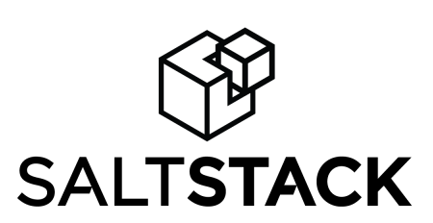
Infrastructure and Configuration as Code
Azure Resource Manager, Automation & 3rd Party Integrations
Infrastructure as Code, built-in
Azure Config & Automation
Support for 3rd party and OSS tooling such as Terraform, Ansible, Chef, Puppet & SaltStack
Notes:
Deploy repeatedly & reliably using Infrastructure as Code
Azure Resource Manager provides these capabilities for Azure out of the box, and works across Azure as well as Azure Stack
But if you’re already using 3rd party tools such as Terraform, Ansible, Chef, Puppet or SaltStack – we support those too!

Slide 15
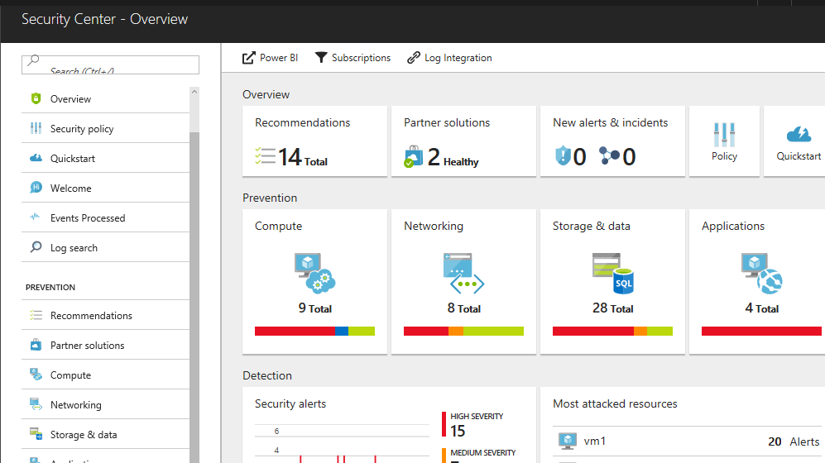
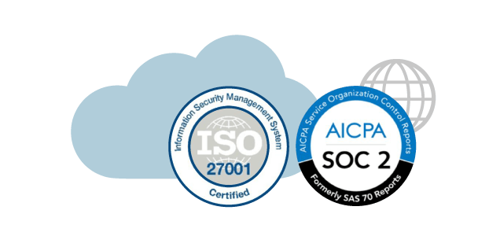
Continuous Security
Azure Security Center
Gain full visibility and control of your cloud security state
Leverage ML to Proactively identify and mitigate risks to reduce exposure to attacks
Quickly detect and respond to threats with advanced analytics
Notes:
Just because you’re moving fast, doesn’t mean you have to lose control – even if you have some Shadow-Ops happening
Azure security gives you visibility and control of your entire cloud security state
Using analytics to provide pro-active recommendations across both Windows and Linux
Leverage services like Azure Event Viewer also to track access, see who change what and when.
------ (additional product context) ------
Secure your cloud resources with Azure Security Center
With Azure Security Center you can gain full visibility and control of your cloud security state with a single, unified view:
Collect security data from multiple sources: Collect, search, and analyze security data from a variety of sources, including connected partner solutions like network firewalls and other Microsoft services.
Integration with existing security workflows: Access, integrate, and analyze security information using REST APIs to connect existing tools and processes.
Easily onboard cloud resources: Keep pace with rapidly changing cloud workloads. Automatically discover and onboard new resources created in your Azure subscriptions.
Continuous security assessment: monitor the security of virtual machines, networks, and Azure services using hundreds of built-in security assessments or create your own.
Built-in dashboards provide instant insights into security issues that require attention.
Centralized policy management: Ensure compliance with company or regulatory security requirements by centrally managing security policies across all your cloud workloads.
Compliance reporting: Use security data and insights to demonstrate compliance and easily generate evidence for auditors.
(If asked whether Azure Security Center supports hybrid workloads, the answer is yes: manage security across all your hybrid cloud workloads – on-premises, Azure, and other cloud platforms – in one console.)
You can also identify and mitigate risks proactively to reduce your exposure to security threats:
Proactive security assessment: Identify software and configurations that are vulnerable to attack.
Actionable recommendations: Remediate security vulnerabilities before they can be exploited by attackers with prioritized, actionable security recommendations and built-in automation playbooks.
Adaptive application controls: Block malware and other unwanted applications by applying whitelisting recommendations adapted to your specific workloads and powered by machine learning.
Controlled network access: Reduce the network attack surface with just-in-time, controlled access to management ports on Azure VMs, drastically reducing exposure to brute force and other network attacks.
Azure Security Center has robust capabilities to prevent attacks. When threats do happen, Security Center can quickly detect and respond to threats with advanced analytics and Microsoft Intelligent Security Graph.
Industry’s most extensive threat intelligence: Tap into the Microsoft Intelligent Security Graph, which uses trillions of signals from Microsoft services and systems around the globe to identify new and evolving threats.
Advanced threat detection: Use built-in behavioral analytics and machine learning to identify attacks and zero-day exploits. Monitor networks, machines, and cloud services for known attack patterns and post-breach activity.
Prioritized alerts and incidents: Focus on the most critical threats first with prioritized security alerts and incidents that map alerts of different types into a single attack campaign. Create your own custom security alerts as well.
Streamlined investigation: Quickly assess the scope and impact of an attack with a visual, interactive experience. Use predefined or ad hoc queries for deeper exploration of security data.
Contextual threat intelligence: Visualize the source of attacks on an interactive world map. Use built-in threat intelligence reports to gain valuable insight into the techniques and objectives of known malicious actors.
At Microsoft, we analyze 300 billion user authentications and check 200 billion emails for spam and malware monthly. We also have unprecedented visibility into cloud infrastructure choices, platforms and the activity therein. Such visibility has no precedent in the on-premises world.

Slide 16
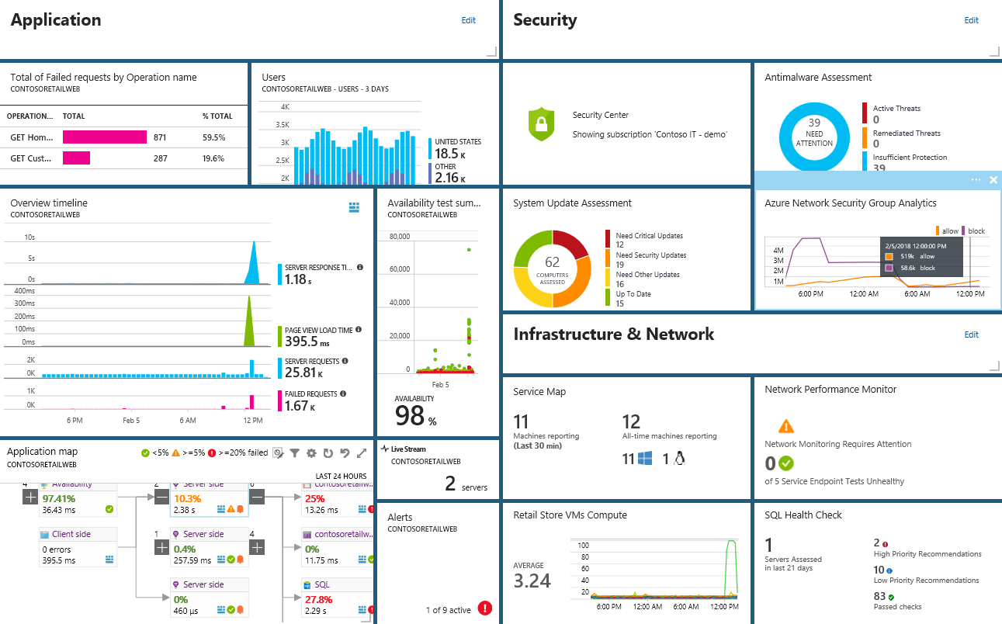
Smarter Insights, Faster
Azure Monitor, Application Insights & Log Analytics
Pre-defined solutions with smart thresholds
Visualize data in intuitive and customizable dashboards
Separate the signal from the noise and accelerate root-cause analysis
Integrate your existing processes & tools like Service Now
Notes:
Azure’s monitoring solutions provide pre-defined solutions with smart thresholds and intuitive dashboards so you can start getting insights straight away
Azure Monitor provides metrics for all Azure infrastructure, building upon that you can leverage both Log Analytics and Application Insights to gain greater insights into your Infrastructure and Applications respectively – leveraging Azure to simplify this into standardized dashboards for both your Developer and your Operations teams
Spend less time separating the signal from the noise and accelerate you root cause analysis
You can also automate and integrate into your existing service desk platforms such as Service Now
------ (additional product context) ------
Monitor your cloud health with Log Analytics
Collect and store your data from any source
Easily collect, store, and analyze your systems and operational data from any source, both on-premises and in the cloud.
Collect data from a wide range of sources including virtual machines, storage accounts, activity logs, Windows, Linux Servers, Java, .NET, legacy and modern apps.
Centrally store activity logs, network logs, infrastructure metrics, app data points, diagnostics logs and alerts.
Gain deep operational insights
Understand CPU disk and memory utilization for your virtual machines.
Get a comprehensive view of applications and network dependencies across multiple virtual machines to perform root-cause analysis more quickly.
Track configuration changes, system updates, and malware status to improve security & compliance.
Visualize data in intuitive and customizable dashboards.
Find the information you need quickly using interactive queries and full-text search.
Detect, diagnose and fix issues quickly
Get notifications and alerts with rich diagnostic information so you can always stay on top of the issues.
Separate the signal from the noise and accelerate root-cause analysis across platforms using advanced analytics including machine learning algorithms.
Automate the implementation of recommended fixes so you can address issues quickly.
Integrate with customer service systems such as your ticketing tool to speed up implementation of fixes.

Slide 17




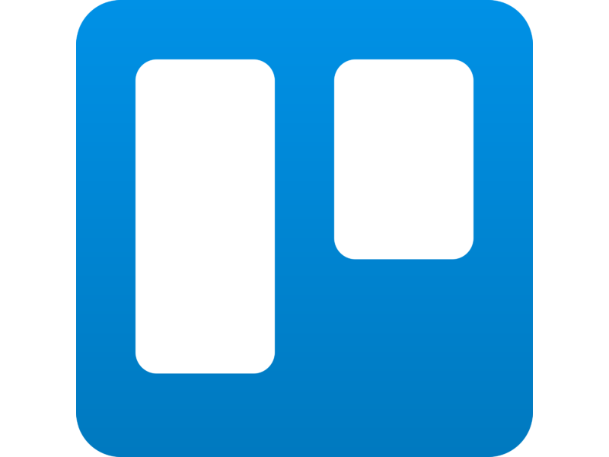


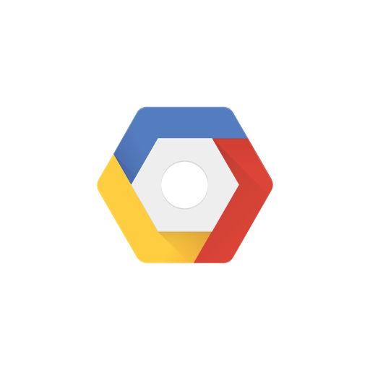

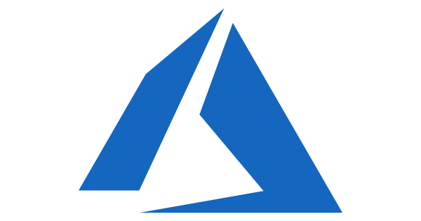

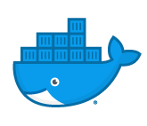
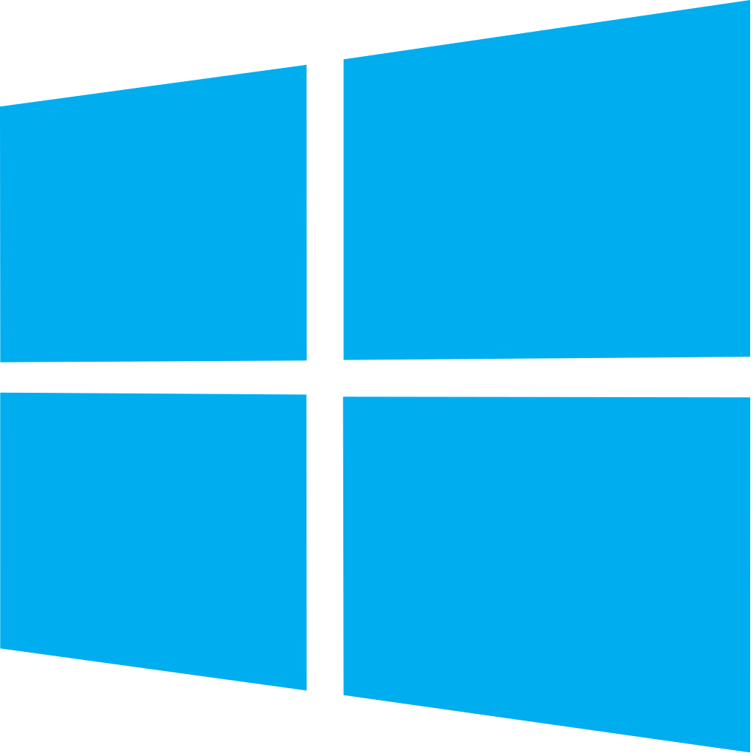


Azure DevOps: Choose the tools and clouds you love
Azure DevOps lets developers choose the tools that are right for them
Mix and match to create workflows with tools from Microsoft, open source or your favorite 3rd party tools
Target any cloud, on-prem or both and deploy to the servers you need

Slide 18
Azure DevOps Services Pricing
Open Source Projects
Small Teams
Teams of any size
Free
Unlimited users and build time
Azure Pipelines: 10 parallel jobs with unlimited minutes for CI/CD
Azure Boards: Work item tracking and Kanban boards
Azure Repos: Unlimited public Git repos
Free
Start free with up to 5 users
Azure Pipelines: Run 1 Microsoft-hosted job for 1,800 minutes per month and 1 self-hosted job for any amount of time
Azure Boards: Work item tracking and Kanban boards
Azure Repos: Unlimited private Git repos
Azure Artifacts: package management
Load testing (20,000 VUMs/month)
Unlimited stakeholders
Starts at $6 per user, per month for Boards & Repos*
Easy pricing that grows with your team
Azure Pipelines: Run 1 Microsoft-hosted job for 1,800 minutes per month and 1 self-hosted job for any amount of time
Azure Boards: Work item tracking and Kanban boards
Azure Repos: Unlimited private Git repos
Azure Artifacts: package management
Load testing (20,000 VUMs/month)
Unlimited stakeholders
Visual Studio subscribers included free
*
https://azure.com/pricing/details/devops/
5 Boards & Repos users and 5 Artifacts users free. Pipelines with unlimited minutes, Test Plans users and additional Artifacts users also available. Please see the Azure pricing calculator for details.
➔

